Slide 1
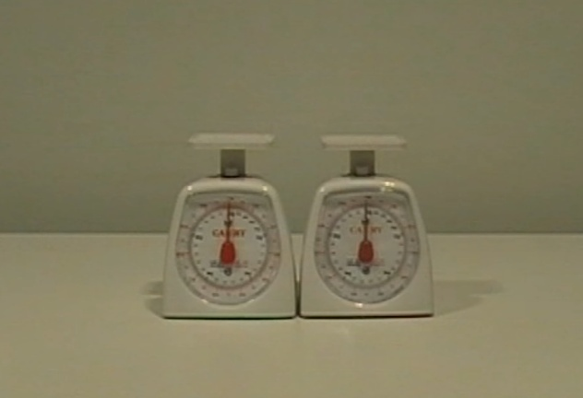
Watch this video…

Slide 2
Your challenge for the day!
Explore the factors affecting the weighing scale reading. Hence explain the differences in the weighing scale readings between the two setups.
Plot suitable graphs using Excel to compare the cases with and without the suspended object.
Describe and explain the effect on the weighing scale reading when the suspended object is replaced by a floating object (e.g. piece of wood).

